Slide 1
Unit IV: Trees and Graphs
Tree terminologies, Binary tree, Tree Transversals (pre-order, post-order and in-order), Operations: Search, Insert, Delete. Binary search tree. Graph terminology, Sequential representation: Adjacency matrix, traversing a Graphs, Breadth first search, Depth first search

Slide 2
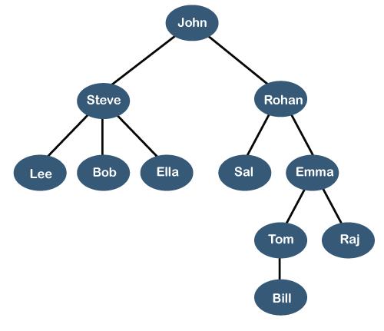
Tree Data Structure
We read the linear data structures like an array, linked list, stack and queue in which all the elements are arranged in a sequential manner. The different data structures are used for different kinds of data.
Some factors are considered for choosing the data structure:
What type of data needs to be stored?: It might be a possibility that a certain data structure can be the best fit for some kind of data.
Cost of operations: If we want to minimize the cost for the operations for the most frequently performed operations. For example, we have a simple list on which we have to perform the search operation; then, we can create an array in which elements are stored in sorted order to perform the binary search. The binary search works very fast for the simple list as it divides the search space into half.
Memory usage: Sometimes, we want a data structure that utilizes less memory.
A tree is also one of the data structures that represent hierarchical data. Suppose we want to show the employees and their positions in the hierarchical form then it can be represented as shown below:

Slide 3
The above tree shows the organization hierarchy of some company. In the above structure, john is the CEO of the company, and John has two direct reports named as Steve and Rohan. Steve has three direct reports named Lee, Bob, Ella where Steve is a manager. Bob has two direct reports named Sal and Emma. Emma has two direct reports named Tom and Raj. Tom has one direct report named Bill. This particular logical structure is known as a Tree. Its structure is similar to the real tree, so it is named a Tree. In this structure, the root is at the top, and its branches are moving in a downward direction. Therefore, we can say that the Tree data structure is an efficient way of storing the data in a hierarchical way.
Let's understand some key points of the Tree data structure.
A tree data structure is defined as a collection of objects or entities known as nodes that are linked together to represent or simulate hierarchy.
A tree data structure is a non-linear data structure because it does not store in a sequential manner. It is a hierarchical structure as elements in a Tree are arranged in multiple levels.
In the Tree data structure, the topmost node is known as a root node. Each node contains some data, and data can be of any type. In the above tree structure, the node contains the name of the employee, so the type of data would be a string.
Each node contains some data and the link or reference of other nodes that can be called children.

Slide 4
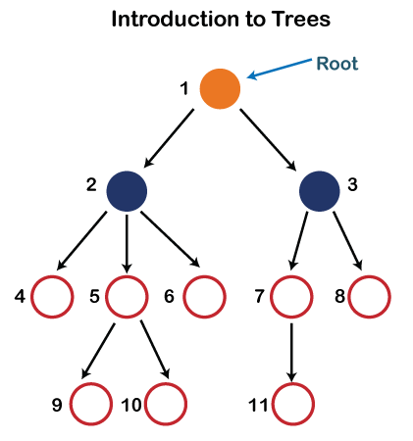
In the above structure, each node is labeled with some number. Each arrow shown in the above figure is known as a link between the two nodes.
Root: The root node is the topmost node in the tree hierarchy. In other words, the root node is the one that doesn't have any parent. In the above structure, node numbered 1 is the root node of the tree. If a node is directly linked to some other node, it would be called a parent-child relationship.
Child node: If the node is a descendant of any node, then the node is known as a child node.
Parent: If the node contains any sub-node, then that node is said to be the parent of that sub-node.
Sibling: The nodes that have the same parent are known as siblings.
Leaf Node:- The node of the tree, which doesn't have any child node, is called a leaf node. A leaf node is the bottom-most node of the tree. There can be any number of leaf nodes present in a general tree. Leaf nodes can also be called external nodes.
Internal nodes: A node has atleast one child node known as an internal
Ancestor node:- An ancestor of a node is any predecessor node on a path from the root to that node. The root node doesn't have any ancestors. In the tree shown in the above image, nodes 1, 2, and 5 are the ancestors of node 10.

Slide 5
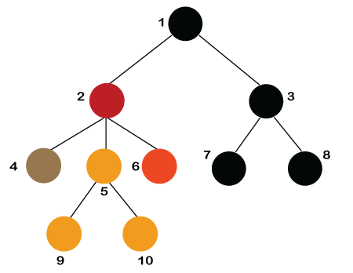
Descendant: The immediate successor of the given node is known as a descendant of a node. In the above figure, 10 is the descendant of node 5.
Properties of Tree data structure
Recursive data structure: The tree is also known as a recursive data structure. A tree can be defined as recursively because the distinguished node in a tree data structure is known as a root node. The root node of the tree contains a link to all the roots of its subtrees. The left subtree is shown in the red color in the below figure, and the right subtree is shown in the black color. The left subtree can be further split into subtrees shown in three different colors. Recursion means reducing something in a self-similar manner. So, this recursive property of the tree data structure is implemented in various applications.
Number of edges: If there are n nodes, then there would n-1 edges. Each arrow in the structure represents the link or path. Each node, except the root node, will have atleast one incoming link known as an edge. There would be one link for the parent-child relationship.

Slide 6
The depth of a node is the number of edges present in path from the root node of a tree to that node.
The height of a node is the number of edges present in the longest path connecting that node to a leaf node.
Applications of trees
The following are the applications of trees:
Storing naturally hierarchical data: Trees are used to store the data in the hierarchical structure. For example, the file system. The file system stored on the disc drive, the file and folder are in the form of the naturally hierarchical data and stored in the form of trees.
Organize data: It is used to organize data for efficient insertion, deletion and searching. For example, a binary tree has a logN time for searching an element.
Routing table: The tree data structure is also used to store the data in routing tables in the routers.

Slide 7
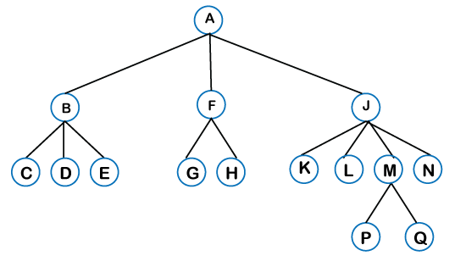
Types of Tree data structure
The following are the types of a tree data structure:
General tree: The general tree is one of the types of tree data structure. In the general tree, a node can have either 0 or maximum n number of nodes. There is no restriction imposed on the degree of the node (the number of nodes that a node can contain). The topmost node in a general tree is known as a root node. The children of the parent node are known as subtrees.
There can be n number of subtrees in a general tree. In the general tree, the subtrees are unordered as the nodes in the subtree cannot be ordered. Every non-empty tree has a downward edge, and these edges are connected to the nodes known as child nodes. The root node is labeled with level 0. The nodes that have the same parent are known as siblings.

Slide 8
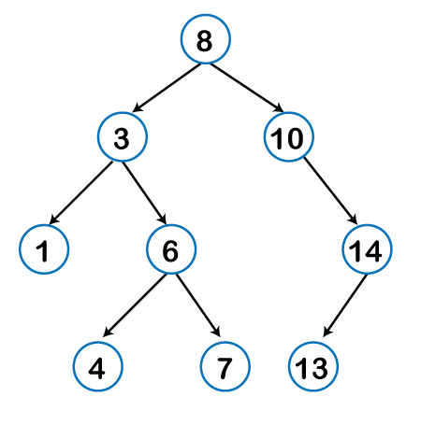
Binary tree: Here, binary name itself suggests two numbers, i.e., 0 and 1. In a binary tree, each node in a tree can have utmost two child nodes. Here, utmost means whether the node has 0 nodes, 1 node or 2 nodes.

Slide 9
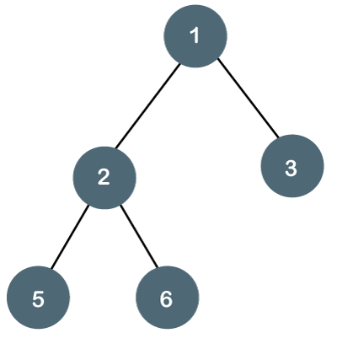
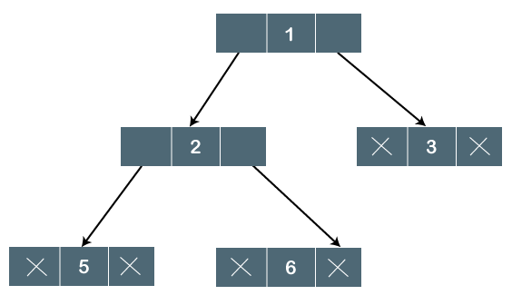
Binary tree
The Binary tree means that the node can have maximum two children. Here, binary name itself suggests that 'two'; therefore, each node can have either 0, 1 or 2 children.
Let's understand the binary tree through an example.
The above tree is a binary tree because each node contains the utmost two children. The logical representation of the above tree is given:
In the above tree, node 1 contains two pointers, i.e., left and a right pointer pointing to the left and right node respectively. The node 2 contains both the nodes (left and right node); therefore, it has two pointers (left and right). The nodes 3, 5 and 6 are the leaf nodes, so all these nodes contain NULL pointer on both left and right parts.

Slide 10
Properties of Binary Tree
At each level of i, the maximum number of nodes is 2^{i}.
The height of the tree is defined as the longest path from the root node to the leaf node. Therefore, the maximum number of nodes at height 3 is equal to (1+2+4+8) = 15. In general, the maximum number of nodes possible at height h is (2⁰ + 2¹ + 2²+….2^{h}) = 2^{h+1} -1.

Slide 11

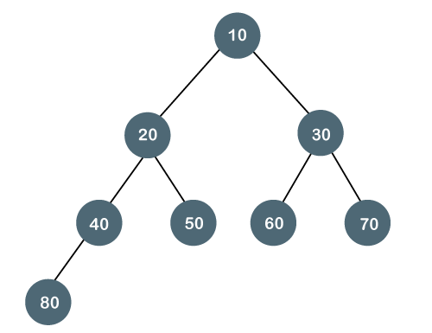
Types of Binary Tree
There are four types of Binary tree:
1. Full/ proper/ strict Binary tree
The full binary tree is also known as a strict binary tree. The tree can only be considered as the full binary tree if each node must contain either 0 or 2 children. The full binary tree can also be defined as the tree in which each node must contain 2 children except the leaf nodes.
Let's look at the simple example of the Full Binary tree.
Complete Binary Tree
The complete binary tree is a tree in which all the nodes are completely filled except the last level. In the last level, all the nodes must be as left as possible. In a complete binary tree, the nodes should be added from the left.

Slide 12
Tree Transversals (pre-order, post-order and in-order)
Traversal is a process to visit all the nodes of a tree and may print their values too. Because, all nodes are connected via edges (links) we always start from the root (head) node. That is, we cannot randomly access a node in a tree. There are three ways which we use to traverse a tree −
In-order Traversal
Pre-order Traversal
Post-order Traversal
Generally, we traverse a tree to search or locate a given item or key in the tree or to print all the values it contains.
In-order Traversal
In this traversal method, the left subtree is visited first, then the root and later the right sub-tree. We should always remember that every node may represent a subtree itself.
If a binary tree is traversed in-order, the output will produce sorted key values in an ascending order.

Slide 13
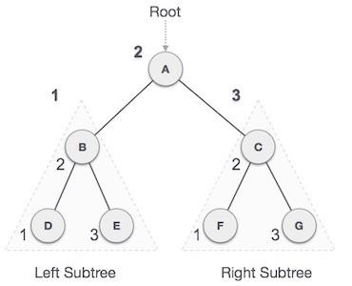
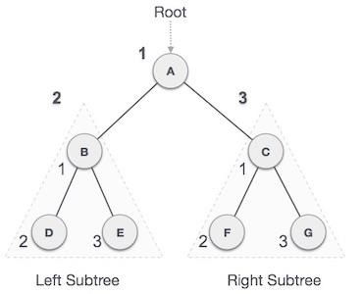
We start from A, and following in-order traversal, we move to its left subtree B.B is also traversed in-order. The process goes on until all the nodes are visited. The output of in-order traversal of this tree will be −
D → B → E → A → F → C → G
Algorithm
Until all nodes are traversed −
Step 1 − Recursively traverse left subtree.
Step 2 − Visit root node.
Step 3 − Recursively traverse right subtree.
Pre-order Traversal
In this traversal method, the root node is visited first, then the left subtree and finally the right subtree.
We start from A, and following pre-order traversal, we first visit A itself and then move to its left subtree B. B is also traversed pre-order. The process goes on until all the nodes are visited. The output of pre-order traversal of this tree will be −
A → B → D → E → C → F → G
Algorithm
Until all nodes are traversed −
Step 1 − Visit root node.
Step 2 − Recursively traverse left subtree.
Step 3 − Recursively traverse right subtree.

Slide 14
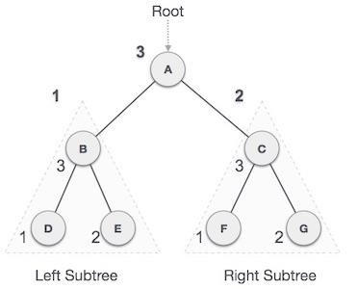
Post-order Traversal
In this traversal method, the root node is visited last, hence the name. First we traverse the left subtree, then the right subtree and finally the root node.
We start from A, and following pre-order traversal, we first visit the left subtree B. B is also traversed post-order. The process goes on until all the nodes are visited. The output of post-order traversal of this tree will be −
D → E → B → F → G → C → A
Algorithm
Until all nodes are traversed −
Step 1 − Recursively traverse left subtree.
Step 2 − Recursively traverse right subtree.
Step 3 − Visit root node.

Slide 15
Operations: Search, Insert, Delete
Searching: For searching elements, we have to traverse all elements (assuming we do breadth-first traversal). Therefore, searching in a binary tree has the worst-case complexity of O(N).
Insertion: To insert an element as a left child, we must traverse all elements. Therefore, insertion in a binary tree has the worst-case O(N) complexity.
Deletion: For element deletion, we have to traverse all elements to find 2 (assuming we do breadth-first traversal). Therefore, deletion in a binary tree has the worst-case O(N) complexity.

Slide 16
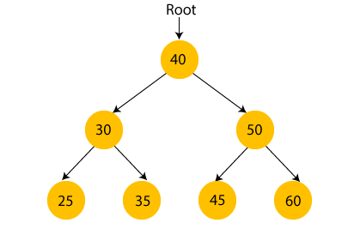
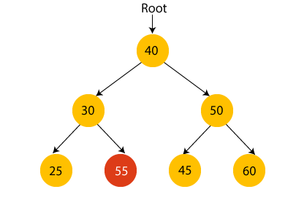
Binary Search tree
A binary search tree follows some order to arrange the elements. In a Binary search tree, the value of left node must be smaller than the parent node, and the value of right node must be greater than the parent node. This rule is applied recursively to the left and right subtrees of the root.
In the above figure, we can observe that the root node is 40, and all the nodes of the left subtree are smaller than the root node, and all the nodes of the right subtree are greater than the root node.
Similarly, we can see the left child of root node is greater than its left child and smaller than its right child. So, it also satisfies the property of binary search tree. Therefore, we can say that the tree in the above image is a binary search tree.
Suppose if we change the value of node 35 to 55 in the above tree, check whether the tree will be binary search tree or not.

Slide 17

In the above tree, the value of root node is 40, which is greater than its left child 30 but smaller than right child of 30, i.e., 55. So, the above tree does not satisfy the property of Binary search tree. Therefore, the above tree is not a binary search tree.
Advantages of Binary search tree
Searching an element in the Binary search tree is easy as we always have a hint that which subtree has the desired element.
As compared to array and linked lists, insertion and deletion operations are faster in BST.
Example of creating a binary search tree
Now, let's see the creation of binary search tree using an example.
Suppose the data elements are - 45, 15, 79, 90, 10, 55, 12, 20, 50
First, we have to insert 45 into the tree as the root of the tree.
Then, read the next element; if it is smaller than the root node, insert it as the root of the left subtree, and move to the next element.
Otherwise, if the element is larger than the root node, then insert it as the root of the right subtree.
Now, let's see the process of creating the Binary search tree using the given data element. The process of creating the BST is shown below –
Step 1 - Insert 45.

Slide 18
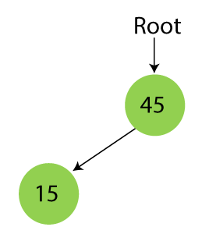
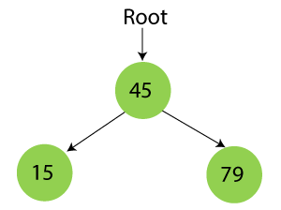
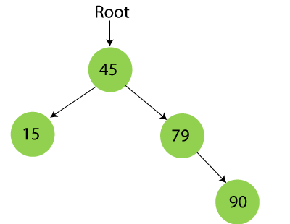
Step 2 - Insert 15.
As 15 is smaller than 45, so insert it as the root node of the left subtree.
Step 3 - Insert 79.
As 79 is greater than 45, so insert it as the root node of the right subtree.
Step 4 - Insert 90.
90 is greater than 45 and 79, so it will be inserted as the right subtree of 79.

Slide 19
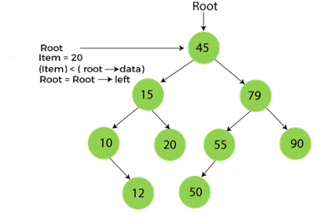
Searching in Binary search tree
Searching means to find or locate a specific element or node in a data structure. In Binary search tree, searching a node is easy because elements in BST are stored in a specific order. The steps of searching a node in Binary Search tree are listed as follows –
First, compare the element to be searched with the root element of the tree.
If root is matched with the target element, then return the node's location.
If it is not matched, then check whether the item is less than the root element, if it is smaller than the root element, then move to the left subtree.
If it is larger than the root element, then move to the right subtree.
Repeat the above procedure recursively until the match is found.
If the element is not found or not present in the tree, then return NULL.
Now, let's understand the searching in binary tree using an example. We are taking the binary search tree formed above. Suppose we have to find node 20 from the below tree.
Step1:

Slide 20
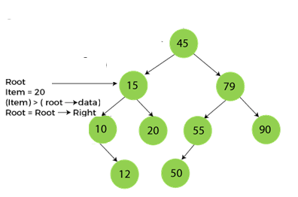
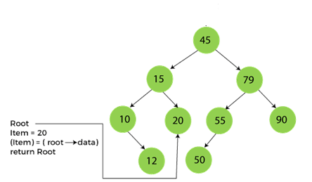
Step2:
Step3:

Slide 21
The complexity of the Binary Search tree
Let's see the time and space complexity of the Binary search tree. We will see the time complexity for insertion, deletion, and searching operations in best case, average case, and worst case.
Time Complexity
Operations | Best case time complexity | Average case time complexity | Worst case time complexity
Insertion | O(log n) | O(log n) | O(n)
Deletion | O(log n) | O(log n) | O(n)
Search | O(log n) | O(log n) | O(n)
Where 'n' is the number of nodes in the given tree.
2. Space Complexity
Operations | Space complexity
Insertion | O(n)
Deletion | O(n)
Search | O(n)

Slide 22
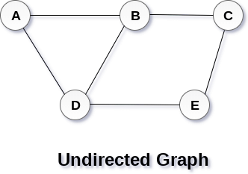
Graph terminology, Sequential representation: Adjacency matrix
Graph
A graph can be defined as group of vertices and edges that are used to connect these vertices. A graph can be seen as a cyclic tree, where the vertices (Nodes) maintain any complex relationship among them instead of having parent child relationship.
Definition
A graph G can be defined as an ordered set G(V, E) where V(G) represents the set of vertices and E(G) represents the set of edges which are used to connect these vertices.
A Graph G(V, E) with 5 vertices (A, B, C, D, E) and six edges ((A,B), (B,C), (C,E), (E,D), (D,B), (D,A)) is shown in the following figure.
Directed and Undirected Graph
A graph can be directed or undirected. However, in an undirected graph, edges are not associated with the directions with them. An undirected graph is shown in the above figure since its edges are not attached with any of the directions. If an edge exists between vertex A and B then the vertices can be traversed from B to A as well as A to B.

Slide 23
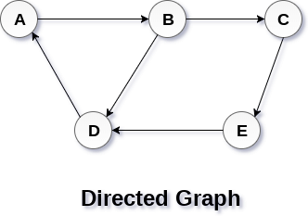
In a directed graph, edges form an ordered pair. Edges represent a specific path from some vertex A to another vertex B.
A directed graph is shown in the following figure.
Graph Terminology
Path
A path can be defined as the sequence of nodes that are followed in order to reach some terminal node V from the initial node U.
Closed Path
A path will be called as closed path if the initial node is same as terminal node. A path will be closed path if V₀=V_{N}.
Cycle
A cycle can be defined as the path which has no repeated edges or vertices except the first and last vertices.

Slide 24
Connected Graph
A connected graph is the one in which some path exists between every two vertices (u, v) in V. There are no isolated nodes in connected graph.
Complete Graph
A complete graph is the one in which every node is connected with all other nodes. A complete graph contain n(n-1)/2 edges where n is the number of nodes in the graph.
Weighted Graph
In a weighted graph, each edge is assigned with some data such as length or weight. The weight of an edge e can be given as w(e) which must be a positive (+) value indicating the cost of traversing the edge.
Adjacent Nodes
If two nodes u and v are connected via an edge e, then the nodes u and v are called as neighbours or adjacent nodes.
Degree of the Node
A degree of a node is the number of edges that are connected with that node. A node with degree 0 is called as isolated node.

Slide 25
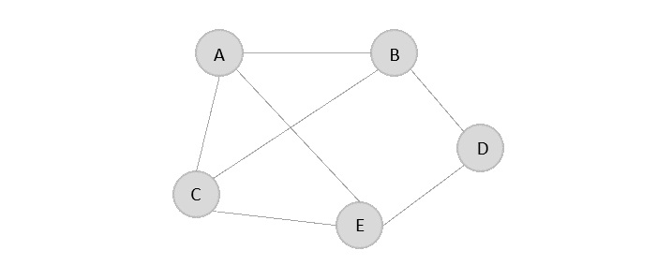
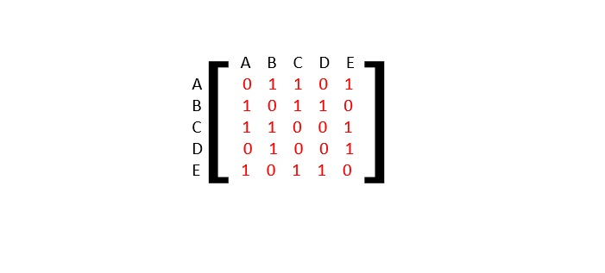
Representation of Graphs
While representing graphs, we must carefully depict the elements (vertices and edges) present in the graph and the relationship between them. Pictorially, a graph is represented with a finite set of nodes and connecting links between them. However, we can also represent the graph in other most commonly used ways, like −
Adjacency Matrix
Adjacency List
Adjacency Matrix
The Adjacency Matrix is a V×V matrix where the values are filled with either 0 or 1. If the link exists between Vi and Vj, it is recorded 1; otherwise, 0.
For the given graph below, let us construct an adjacency matrix −

Slide 26
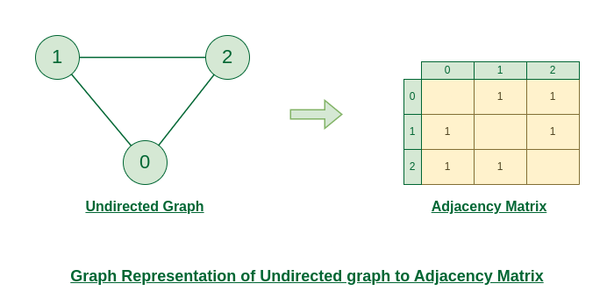
Representation of Undirected Graph to Adjacency Matrix:
The below figure shows an undirected graph. Initially, the entire Matrix is ​​initialized to 0. If there is an edge from source to destination, we insert 1 to both cases (adjMat[destination] and adjMat[destination]) because we can go either way.

Slide 27
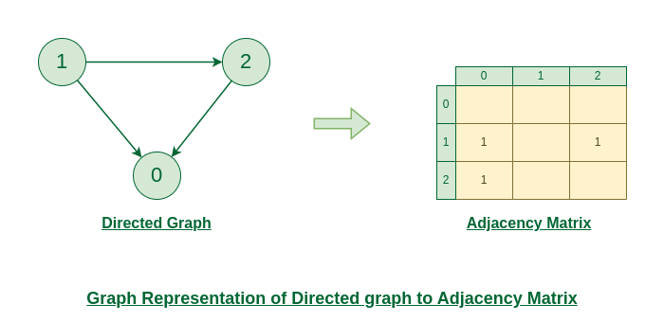
Representation of Directed Graph to Adjacency Matrix:
The below figure shows a directed graph. Initially, the entire Matrix is ​​initialized to 0. If there is an edge from source to destination, we insert 1 for that particular adjMat[destination].

Slide 28
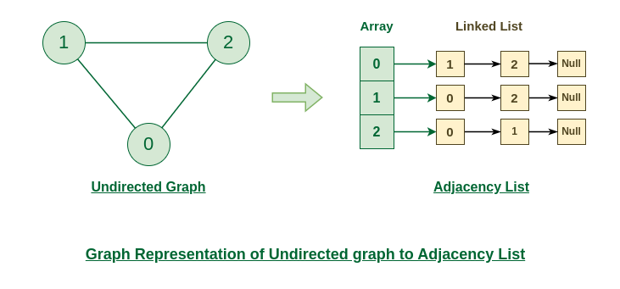
Adjacency Lists
An array of Lists is used to store edges between two vertices. The size of array is equal to the number of vertices (i.e, n). Each index in this array represents a specific vertex in the graph. The entry at the index i of the array contains a linked list containing the vertices that are adjacent to vertex i.
Let’s assume there are n vertices in the graph So, create an array of list of size n as adjList[n].
adjList[0] will have all the nodes which are connected (neighbour) to vertex 0.
adjList[1] will have all the nodes which are connected (neighbour) to vertex 1 and so on.
Representation of Undirected Graph to Adjacency list:

Slide 29
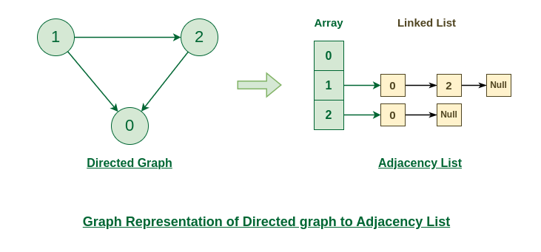
Representation of Directed Graph to Adjacency list:

Slide 30
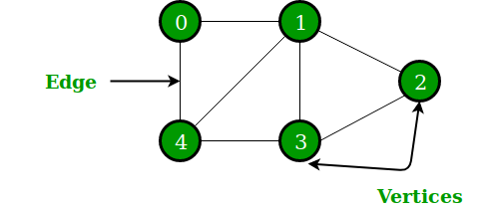
Applications of Graph Data Structure
Google maps uses graphs for building transportation systems, where intersection of two(or more) roads are considered to be a vertex and the road connecting two vertices is considered to be an edge, thus their navigation system is based on the algorithm to calculate the shortest path between two vertices.
In Facebook, users are considered to be the vertices and if they are friends then there is an edge running between them. Facebook’s Friend suggestion algorithm uses graph theory. Facebook is an example of undirected graph.
In World Wide Web, web pages are considered to be the vertices. There is an edge from a page u to other page v if there is a link of page v on page u. This is an example of Directed graph.
Microsoft Excel uses DAG means Directed Acyclic Graphs.
On social media sites, we use graphs to track the data of the users, like showing preferred post suggestions, recommendations, etc.
A directed acyclic graph (DAG) is a conceptual representation of a series of activities. The order of the activities is depicted by a graph, which is visually presented as a set of circles, each one representing an activity, some of which are connected by lines, which represent the flow from one activity to another.

Slide 31
Traversing a Graphs, Breadth first search, Depth first search
BFS algorithm
Breadth-first search is a graph traversal algorithm that starts traversing the graph from the root node and explores all the neighboring nodes. Queue data structure is used for the implementation of BFS. This will ensure that those things that were discovered first will be explored first, before exploring those that were discovered subsequently. Then, it selects the nearest node and explores all the unexplored nodes. While using BFS for traversal, any node in the graph can be considered as the root node.
There are many ways to traverse the graph, but among them, BFS is the most commonly used approach. It is a recursive algorithm to search all the vertices of a tree or graph data structure. BFS puts every vertex of the graph into two categories - visited and non-visited. It selects a single node in a graph and, after that, visits all the nodes adjacent to the selected node.
Applications of BFS algorithm
The applications of breadth-first-algorithm are given as follows -
BFS can be used to find the neighboring locations from a given source location.
In a peer-to-peer network, BFS algorithm can be used as a traversal method to find all the neighboring nodes. Most torrent clients, such as BitTorrent, uTorrent, etc. employ this process to find "seeds" and "peers" in the network.
BFS can be used in web crawlers to create web page indexes. It is one of the main algorithms that can be used to index web pages. It starts traversing from the source page and follows the links associated with the page. Here, every web page is considered as a node in the graph.

Slide 32
BFS is used to determine the shortest path and minimum spanning tree.
It can be used in ford-Fulkerson method to compute the maximum flow in a flow network.
We use the following steps to implement BFS traversal
Step 1 - Define a Queue of size total number of vertices in the graph.
Step 2 - Select any vertex as starting point for traversal. Visit that vertex and insert it into the Queue.
Step 3 - Visit all the non-visited adjacent vertices of the vertex which is at front of the Queue and insert them into the Queue.
Step 4 - When there is no new vertex to be visited from the vertex which is at front of the Queue then delete that vertex.
Step 5 - Repeat steps 3 and 4 until queue becomes empty.
Step 6 - When queue becomes empty, then produce final spanning tree by removing unused edges from the graph

Slide 33
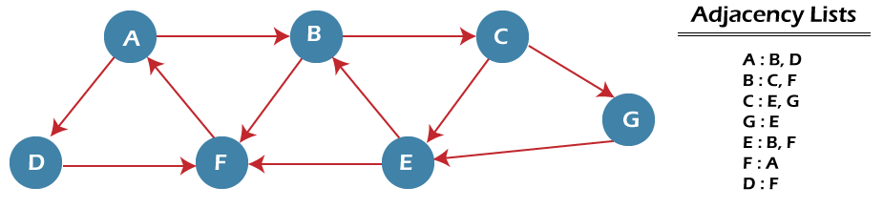
Example of BFS algorithm
Now, let's understand the working of BFS algorithm by using an example. In the example given below, there is a directed graph having 7 vertices.
In the above graph, minimum path 'P' can be found by using the BFS that will start from Node A and end at Node G. The algorithm uses two queues, namely QUEUE1 and QUEUE2. QUEUE1 holds all the nodes that are to be processed, while QUEUE2 holds all the nodes that are processed and deleted from QUEUE1.
Now, let's start examining the graph starting from Node A.

Slide 34
Step 1 - First, add A to queue1 and NULL to queue2.
QUEUE1 = {A}
QUEUE2 = {NULL}
Step 2 - Now, delete node A from queue1 and add it into queue2. Insert all neighbors of node A to queue1.
QUEUE1 = {B, D}
QUEUE2 = {A}
Step 3 - Now, delete node B from queue1 and add it into queue2. Insert all neighbors of node B to queue1.
QUEUE1 = {D, C, F}
QUEUE2 = {A, B}
Step 4 - Now, delete node D from queue1 and add it into queue2. Insert all neighbors of node D to queue1. The only neighbor of Node D is F since it is already inserted, so it will not be inserted again.
QUEUE1 = {C, F}
QUEUE2 = {A, B, D}
Step 5 - Delete node C from queue1 and add it into queue2. Insert all neighbors of node C to queue1.
QUEUE1 = {F, E, G}
QUEUE2 = {A, B, D, C}

Slide 35
Step 6 - Delete node F from queue1 and add it into queue2. Insert all neighbors of node F to queue1. Since all the neighbors of node F are already present, we will not insert them again.
QUEUE1 = {E, G}
QUEUE2 = {A, B, D, C, F}
Step 7 - Delete node E from queue1. Since all of its neighbors have already been added, so we will not insert them again. Now, all the nodes are visited, and the target node E is encountered into queue2.
QUEUE1 = {G}
QUEUE2 = {A, B, D, C, F, E}
Complexity of BFS algorithm
Time complexity of BFS depends upon the data structure used to represent the graph. The time complexity of BFS algorithm is O(V+E), since in the worst case, BFS algorithm explores every node and edge. In a graph, the number of vertices is O(V), whereas the number of edges is O(E).
The space complexity of BFS can be expressed as O(V), where V is the number of vertices.

Slide 36
DFS (Depth First Search) algorithm
It is a recursive algorithm to search all the vertices of a tree data structure or a graph. The depth-first search (DFS) algorithm starts with the initial node of graph G and goes deeper until we find the goal node or the node with no children.
Because of the recursive nature, stack data structure can be used to implement the DFS algorithm.
The process of implementing the DFS is similar to the BFS algorithm.
The step by step process to implement the DFS traversal is given as follows -
First, create an empty stack with the total number of vertices in the graph.
Now, choose any vertex as the starting point of traversal, and push that vertex into the stack.
After that, push a non-visited vertex (adjacent to the vertex on the top of the stack) to the top of the stack.
Now, repeat steps 3 and 4 until no vertices are left to visit from the vertex on the stack's top.
If no vertex is left, go back and pop a vertex from the stack.
Repeat steps 2, 3, and 4 until the stack is empty.
Applications of DFS algorithm
The applications of using the DFS algorithm are given as follows –
It can be used to find the paths between two vertices.
It can also be used to detect cycles in the graph.
DFS algorithm is also used for one solution puzzles.

Slide 37
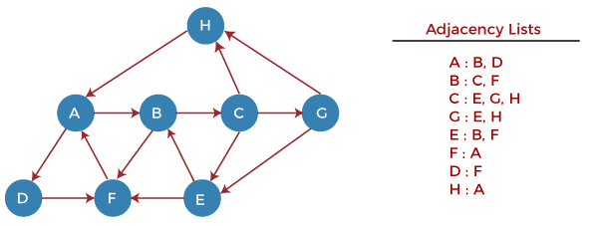
Example of DFS algorithm
Now, let's understand the working of the DFS algorithm by using an example. In the example given below, there is a directed graph having 7 vertices.
Now, let's start examining the graph starting from Node H.
Step 1 - First, push H onto the stack.
STACK: H
Step 2 - POP the top element from the stack, i.e., H, and print it. Now, PUSH all the neighbors of H onto the stack that are in ready state.
Print:H STACK: A
Step 3 - POP the top element from the stack, i.e., A, and print it. Now, PUSH all the neighbors of A onto the stack that are in ready state.
Print: A
STACK: B, D
Step 4 - POP the top element from the stack, i.e., D, and print it. Now, PUSH all the neighbors of D onto the stack that are in ready state.
Print: D
STACK: B, F
Step 5 - POP the top element from the stack, i.e., F, and print it. Now, PUSH all the neighbors of F onto the stack that are in ready state.
Print: F
STACK: B

Slide 38
Step 6 - POP the top element from the stack, i.e., B, and print it. Now, PUSH all the neighbors of B onto the stack that are in ready state.
Print: B
STACK: C
Step 7 - POP the top element from the stack, i.e., C, and print it. Now, PUSH all the neighbors of C onto the stack that are in ready state.
Print: C
STACK: E, G
Step 8 - POP the top element from the stack, i.e., G and PUSH all the neighbors of G onto the stack that are in ready state.
Print: G
STACK: E
Step 9 - POP the top element from the stack, i.e., E and PUSH all the neighbors of E onto the stack that are in ready state.
Print: E
STACK:
Now, all the graph nodes have been traversed, and the stack is empty.
DFS: HADFBCGE
Complexity of Depth-first search algorithm
The time complexity of the DFS algorithm is O(V+E), where V is the number of vertices and E is the number of edges in the graph.
The space complexity of the DFS algorithm is O(V).

